Slide 1

SMART HOME SECURITY SYSTEM
PROJECT REPORT
Submitted by
Lohith Reddy (AM.SC.U4AID24053)
O.V. Mounish Kumar (AM.SC.U4AID24033)
P. Manikanta (AM.SC.U4AID24035)
S. Akhil Reddy (AM.SC.U4AID2407044)
S. Rishwanth Sai (AM.SC.U4AID24070)
As a part of Project-based evaluation on 23EEE103 Introduction to Electrical Engineering
BACHELOR OF TECHNOLOGY
IN
ARTIFICIAL INTELLIGENCE AND DATA SCIENCE
AMRITA VISHWA VIDYAPEETHAM AMRITAPURI CAMPUS NOVEMBER 2024

Slide 2
TABLE OF CONTENTS
Chapter | Title | Page.No
1 | INTRODUCTION | 1 - 3
2 | REVIEW OF LITERATURE | 4 - 5
3 | DESIGN CONSIDERATIONS | 6 - 14
4 | CIRCUIT DIAGRAM | 15 - 16
5 | IMPLEMENTATION AND RESULTS | 17 - 18
6 | ADVANTAGES AND APPLICATIONS | 19
7 | CONCLUSION AND FUTURE SCOPE | 20

Slide 3
With the growing security issues, the conventional security systems lack in providing sophisticated and tamper-proof protection. Our project, Laser Light Security System with Fingerprint Sensor, combines laser technology with biometric authentication to form a robust security solution. This innovative system ensures restricted access to authorized individuals, making it ideal for applications in homes, offices, and secure facilities. The system contains a fingerprint sensor for biometric verification, a laser module, a light-dependent resistor (LDR) to detect interruptions, and a relay-controlled locking mechanism. When a user places their finger on the sensor, their biometric data is compared with pre-stored information. Only if the3 fingerprint is authorized does the laser system activate, ensuring dual-level security. Any unauthorized access attempt triggers alarms or other countermeasures.
Key components include a 5V relay module, a BC547 transistor, and a 10k ohm resistor, which together control the laser and locking mechanism. The fingerprint sensor ensures biometric precision, while the laser and LDR system provides continuous monitoring. These components are carefully chosen for their reliability, low power consumption, and affordability, making the system both efficient and cost-effective.
The dual-layered security approach enhances safety by combining biometric authentication and real-time monitoring. The system is versatile, scalable, and can be customized for various security scenarios. Its potential applications extend beyond residential and commercial premises to include high-security areas like banks, data centers, and research labs. The Laser Light Security System with Fingerprint Sensor is a significant innovation in modern security systems. It offers high accuracy and reliability by using laser technology and biometric authentication. The system is user-friendly, cost-efficient, and adaptable, making it a viable solution for current and future security challenges.
ABSTRACT

Slide 4
CHAPTER 1
INTRODUCTION
1.1 BACKGROUND
Advancements in photonics and automation technologies have significantly reduced the requirement for human intervention in several sectors, especially in security systems. Laser security systems, using laser technology, are increasingly deployed to increase safety and protect sensitive areas from unauthorized access. The ability to detect and respond to threats in real time has become a vital aspect of modern security infrastructure.
In high-risk environments such as restricted zones, industrial facilities, and government buildings, security threats can arise unexpectedly, jeopardizing both human lives and valuable assets. Traditional security measures, like motion detectors, infrared sensors, or CCTV surveillance, tend to have limited ranges and accuracy, as well as response times. Such systems are usually dependent on the manual monitoring of human elements or delayed reactions that permit damage. The laser security system offers a solution that detects disturbances in a laser beam and initiates alarms or security protocol without the involvement of any human element.
This project focuses on developing a laser security system that integrates advanced laser sensors with automated response mechanisms, ensuring continuous monitoring and rapid, reliable detection and prevention of unauthorized access. By leveraging cutting-edge laser technology, this system aims to enhance overall security and provide a highly efficient solution to modern security challenges.
1.2 OBJECTIVES
Objective: Design a low-cost and reliable laser security system using basic electronic
components such as laser sensors and transistors.
Function: The system will utilize focused laser beams to monitor a defined area and aadetect disturbances caused by intrusions or unauthorized access.
Automation: No human intervention required; the system automatically detects aaintrusions and activates security measures such as alarms or lock-down protocols.
Early Detection: The system detects intrusions early and responds autonomously, aaproviding enhanced protection against unauthorized access to sensitive areas.
Vulnerability of High-Risk Environments: Despite widespread use of conventional aasecurity systems, many high-risk environments like restricted zones, industrial aafacilities, and government buildings remain vulnerable to intrusions.
Major Threats: The primary threats in these areas include theft, vandalism, and aaespionage, which can result in significant financial losses and compromise sensitive aainformation.
Impact: This project aims to improve security in vulnerable locations, reduce the aaneed for human intervention, and enhance overall safety.

Slide 5
1.3 RELEVANCE
The Laser Security System is very relevant in terms of modern security needs; it is driven by a growing threat of security and by the need for better security in sensitive areas. Unregulated access, theft, and vandalism are on the rise and thus the need for state-of-the-art security is critical. This project finds relevance in several key areas, including:
Enhanced Security and Protection :
The laser security system provides a means of protecting lives, assets, and sensitive information from threats. Unlike the traditional security systems such as CCTV or motion sensors, which can only be monitored manually, the laser security system offers the monitoring of the place round the clock. It detects any intrusions immediately and triggers alarm or security measures instantly. This system is particularly valuable in: High-security zones like government buildings or research facilities.-Availability of sensitive locations such as data centers and financial institutions.
Protection from Unauthorized Access and Security Violations :
An intruder may cause a breach of security and theft during any intrusion, especially in dangerous zones. The laser security system responds independently to any identified disturbance and prevents further invasion, thereby reducing possible loss. This system is used in industries that involve significant asset values or classified information like data centers and financial banks.- Industrial plants and warehouses storing high-value goods. -Military and government facilities where unauthorized access could threaten national security.
Meeting Security Standards and Regulations :
As the security regulations get tougher, the industries have been taking advanced technologies like laser security systems into operation. The system provides extra protection beyond what is achieved through traditional systems, thus it is very relevant to property developers and building managers, adhering to the new and emerging security standards, as well as organizations with critical infrastructure and confidential information.
Educational Value :
This project is very relevant both in terms of fire safety but also strong in education.It is a very good learning tool for students as well as engineers.
1.4 REPORT ORGANIZATION
This report is divided into separate chapters, with each chapter dealing with different aspects of the project. Each chapter gives a detailed analysis and explanation of its corresponding components and technical specifications. Let us now go through each chapter to discuss the methodologies, design considerations, and technical details involved in this project.

Slide 6
Chapter-1 deals with introduction, background, relevance and report organization Chapter-2 deals with review of literature
Chapter-3 deals with design consideration
Chapter-4 deals with circuit diagram of our finalized circuit
Chapter-5 deals with implementation and results
Chapter-6 deals with advantages and application
Chapter-7 deals with conclusion and future scope
This report is structured to give an orderly presentation of all the aspects of our project. Each section will specifically deal with technical components and methodologies. The design, implementation, and testing phases are covered in depth in this report. Lastly, the report concludes with a comprehensive list of references to support the literature review and further contextualize the theoretical and practical foundations of the project.

Slide 7
CHAPTER 2
REVIEW OF LITERATURE
The design and implementation of a laser-based security system. This system uses laser transmitters and receivers to create an invisible perimeter. When an intruder disrupts the laser beam, it triggers an alarm, enhancing security. The study emphasizes the system's sensitivity, reliability, and potential for practical applications in areas like asset protection and perimeter defense. The system works by using a Light Dependent Resistor (LDR) that detects changes in light intensity caused by interruptions in the laser beam. When the laser is blocked, the LDR's resistance increases, activating an alarm. A BC547 transistor is used to trigger the alarm when the laser beam is disturbed. The system was successfully tested, and results showed that it functions as expected, providing an effective, affordable, and reliable security solution. The laser security system is ideal for both home and business applications, offering enhanced protection against theft and crime [1]
The design and implementation of laser-based security systems focus on using laser beams and light-dependent resistors (LDRs) to detect intrusions. When the laser beam is interrupted, an alarm is triggered, alerting homeowners or organizations to potential threats. Various studies showcase different configurations:
Arduino Integration: Systems using Arduino UNO can incorporate sensors, Wi-Fi modules, and cameras to capture images of intruders and send alerts via email.
Mirror Systems: Some designs utilize mirrors to reflect laser beams in all directions, enhancing coverage and triggering alarms when the beam is obstructed.
Voltage-Based Detection: Other systems monitor voltage changes across LDRs to activate alarms when an intrusion is detected.
Advanced Access Control: Projects also explore integrating QR codes with Raspberry Pi for secure access monitoring, particularly in laboratory settings.
Overall, these innovations represent significant advancements in security technology, offering effective solutions for protecting homes and organizations. [2]
This system works on the idea of transmitting laser light in a monitored area and detecting it by an LDR module. Any interruption in the laser beam will trigger ESP32 CAM to capture an image of the intruder and send a notification alert to any device connected to Wi-Fi. This provides an efficient, invisible security solution because laser rays cannot be seen with the naked eye. The system is proposed as an affordable and effective alternative to the traditional surveillance methods like CCTV, which are more conspicuous. The methodology highlights how the module of ESP32 CAM would work as the core module capturing images and transmitting them through the application of Blynk, meaning users can monitor security online in real-time from any area. It's a security document that aims at giving a laser-based security system in order to detect intruders and improve safety. It has main components such as ESP32 CAM, LDR module, laser module, and Blynk application

Slide 8
Including literature review proves that this design extends improved facilities such as remote monitoring more developed improvements rather than using buzzers used earlier systems. The true feature of the system was taking an advantage of undetectable laser beam combining a light-dependent resistor where they measure an intruder after finding entrance into the house because afterwards an intruder's image capture sends through to ensure monitoring process is done without knowing its awareness by the intruder [3]
The system utilizes laser beams cast across a boundary area, and laser transmitters and light-dependent resistors form the heart of this system. An alarm will be triggered upon
resistance. Laser light therefore has the unique property that it travels with such narrow, monochromatic, and focused light to ensure good precision over quite long distances.
The methodology includes the use of an operational amplifier, acting as a comparator for detecting voltage differences resulting from changes in LDR resistance during interruption by a laser beam. A 555 Timer IC is used in a bi-stable multivibrator mode to trigger a buzzer as an alarm. It could extend its applications from household security to protecting high-value assets.
This scheme gives way to the idea of building an affordable and efficient laser perimeter security system that, in its basic implementation, integrates lasers with LDRs to ensure precise detection of intrusions. It is accessible to sample use when common, cost-effective components are used to answer modern security needs. [4]
The Laser Security Alarm System is an effective and efficient way to secure areas by detecting intrusions using laser beams. The fundamental concept revolves around the principle of a laser transmitter emitting a focused beam, which is continuously monitored by a receiver. An interruption in this beam due to an intruder or object triggers an alert through a connected alarm unit. The system is based on components such as a laser diode, a light-dependent resistor (LDR), transistors, and a buzzer alarm. It detects the changes in light intensity on the LDR using the voltage divider principle. The benefits include high accuracy, low power consumption, long distance coverage, and quick response time. However, its performance may be affected by environmental conditions such as fog, dust, or rain, hence requiring regular maintenance and calibration. In conclusion, This system forms a cost-effective and scalable security measure. It maximizes security efficiency when integrated with high technologies such as wireless communication. Although it is exposed to environmental limitations, its features of affordability and reliability mean that it can be widely applied in various scenarios. [5]

Slide 9
CHAPTER 3
DESIGN CONSIDERATIONS
Designing a laser security system must be all-inclusive to provide maximal performance, accuracy, and reliability in the entire system. Essentially, its primary aim should be real-time detection of unauthorized access or intrusion attempts and then autonomous response toward improving security. This can only be achieved by incorporating various critical parts such as laser sensors, transistors, alarm systems, response mechanisms, and power management in order to factor in the environment, particularly the lighting conditions, limitations of ranges, and interference. Another important factor is careful calibration of the system, processing of data, and security measures to allow the system to operate effectively and efficiently in a wide variety of security environments.
3.1 Components Required
R307S Fingerprint sensor
Laser Light Module
Arduino UNO
5V Relay Module
BC547 Transistor
10k Ohm Resistor
Buzzer
Power Supply (5V DC)
Connecting Wires
Breadboard
3.1.1 R307S FINGERPRINT SENSOR
The R307 is a compact optical biometric product designed for accurate fingerprint recognition and uses advanced optical scanning technologies to capture high-quality fingerprints, which are then processed and kept for matching. The amount of fingerprint templates that the sensor can store is quite extensive, making it suitable for access control, security systems, and authentication applications. UART (Universal Asynchronous Receiver/Transmitter) and TTL (Transistor-Transistor Logic) are the communication interfaces that are used for seamless integration with microcontrollers and embedded systems. They enable easy data transmission and control.

Slide 10
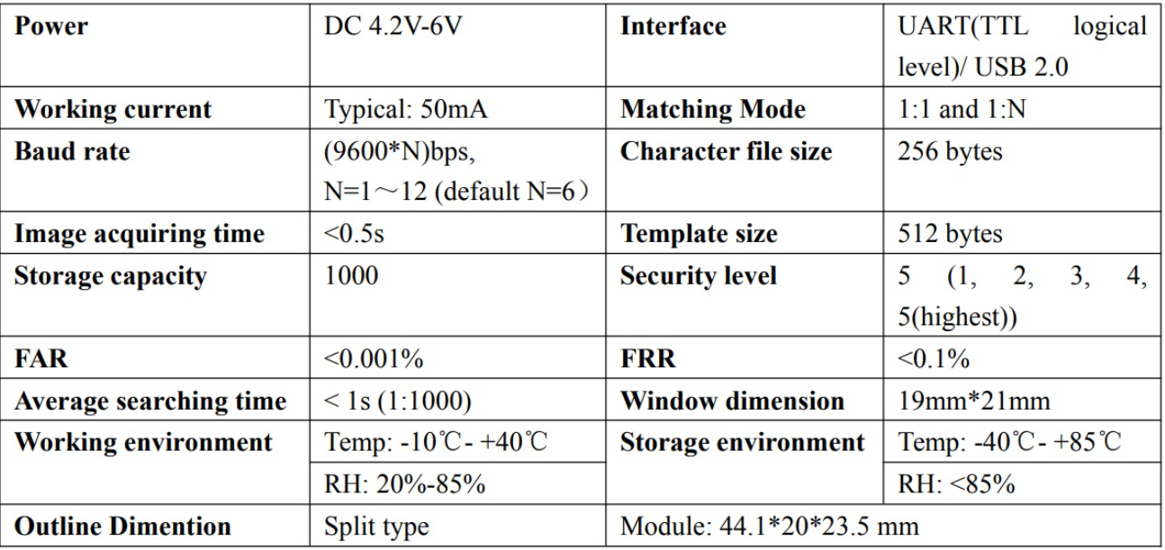
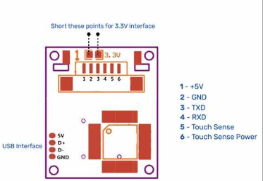
SPECIFICATIONS :
Table 1
PIN DIAGRAM :
Finger print Sensor 3.1
TXD : Transmit pin
RXD : Receiver pin
VCC : Power Supply
GND : Ground

Slide 11
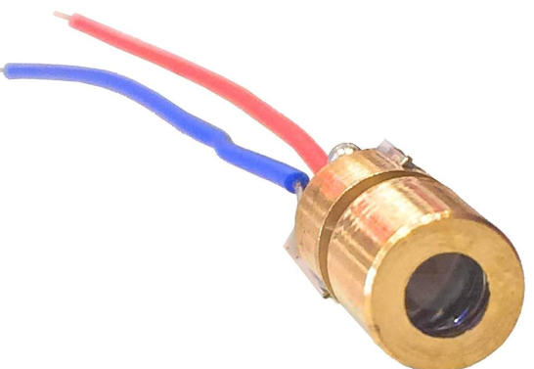
3.1.2 LASER LIGHT MODULE :
A laser is an optical amplifier that emits light by stimulated emission of electromagnetic radiation. Unlike other light sources, lasers emit light coherently; this coherence allows spatial coherence to focus beams for applications such as laser cutting and lithography. This coherence also keeps laser beams narrow over long distances, as in laser pointers. Lasers can emit light with a narrow spectrum and generate pulses as short as a femto second.
SPECIFICATIONS :
Table 2
Parameter | Symbol | Ratings | Unit
Optical Output | Po | 10 | mW
Reverse Voltage(LD) | Vr | 2 | V
Reverse Voltage(Pin PD) | Vr (PD) | 20 | V
Operating Temp. | Top | -40 to 80 | C
Storage Temp. | Tstg | -40 to 85 | C
LASER MODULE DIAGRAM :
Laser Module 3.2

Slide 12
3.1.3 ARDUINO UNO :
Arduino is an open-source electronics platform based on simple hardware and software designed for creating interactive projects. This platform uses a microcontroller, which can be programmed to manage sensors, motors, lights, and more. Arduino has become popular for its usability and ease of use. The IDE of Arduino, for coding, is quite user-friendly, with a range of shields and modules that makes it versatile for prototyping and development. Arduino's open-source nature encourages community collaboration, with countless resources and libraries available for various applications.
SPECIFICATIONS :
Table 3
Specifications | Details
Operating Voltage | 5V
Digital I/O Pins | 14 (of which 6 provide PWM output)
PWM Digital I/O Pins | 6 (Pins 3, 5, 6, 9, 10, 11)
Analog Input Pins | 6 (A0 to A5)
DC Current per I/O Pin | 20 mA
Flash Memory | 32 KB (0.5 KB used for the boot loader)
SRAM | 2 KB
EEPROM | 1 KB
Clock Speed | 16 MHz
Communication Ports | UART (Serial), SPI, and I2C
USB Port | USB Type-B for programming and power
Power Connector | Barrel Jack or USB
Input Voltage (Limits) | 6-20V
Microcontroller | ATmega328P

Slide 13
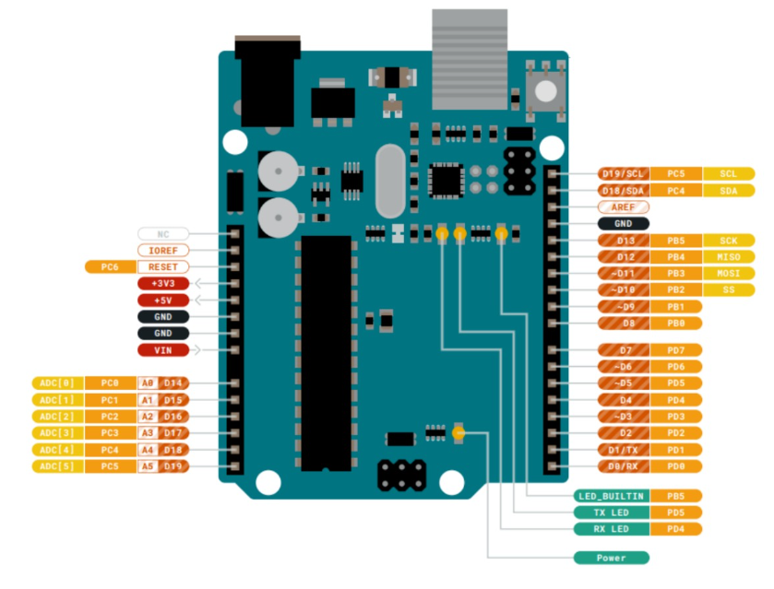
ARDUINO UNO DIAGRAM :
Arduino UNO 3.3
TX (Pin 1): Transmit pin for sending serial data.
RX (Pin 0): Receive pin for receiving serial data.
SDA (A4): Serial Data line for I2C communication.
SCL (A5): Serial Clock line for I2C communication.
MOSI (Pin 11): Master Out Slave In.
MISO (Pin 12): Master In Slave Out.
SCK (Pin 13): Serial Clock.
SS (Pin 10): Slave Select.
Analog Pins: A0–A5.
Digital Pins: 0–13
Power Pins: Vin, 5V, 3.3V, GND.
USB Port: For programming and power.

Slide 14
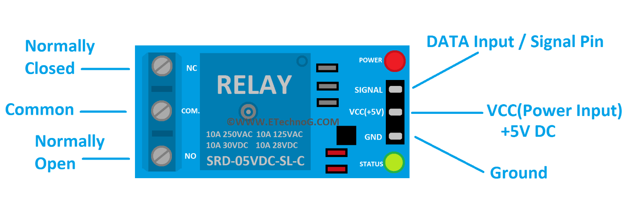
3.1.4 RELAY MODULE
A 5V relay is an electrical switch operated by a 5V control signal, which is from a microcontroller like Arduino. It works on an electromagnet that opens and closes the circuit, giving the ability for low-voltage devices to control loads with higher voltage. This relay consists of a coil, contacts, and a mechanical armature that move in response to energizing. It is commonly used in applications for switching automation, appliances at home, and industrial control systems. Such as a 5V relay-which works with a standard, everyday circuit-a is available for compatibility with a simple 5V logic systems.
SPECIFICATIONS :
Table 4
Specification | Details
Operating Voltage | 5V DC
Trigger Voltage | 3.3V to 5V DC
Channel | 1
Current Rating | 10A at 250V AC
Contact Type | Normally Open (NO) and Normally Closed (NC)
Control Signal | TTL Logic (low-level or high-level trigger)
Relay Lifetime | 100,000+ switching operations
5V RELAY MODULE DIAGRAM :
Relay 3.4

Slide 15
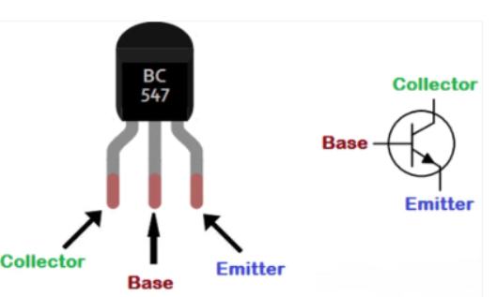
3.1.5 BC547 TRANSISTOR
The BC547 is a widely used NPN bipolar junction transistor (BJT) for low-power amplification and switching applications. It has three terminals: collector, base, and emitter, and operates with a maximum voltage of 45V and a current of up to 100mA. The BC547 is commonly used in signal processing, audio amplifiers, and electronic circuits for switching purposes. Its small size and reliability make it ideal for hobby projects and low-power electronic devices. It is widely available and is used frequently in conjunction with other components, such as resistors and capacitors, to achieve a wide range of purposes.
SPECIFICATIONS :
Table 7
SYMBOL | PARAMETER |  | VALUE | UNIT
VCBO | COLLECTOR-BASE VOLTAGE | BC546 | 80 | V
 |  | BC547/BC550 | 50
 |  | BC548/BC549 | 30
VCEO | COLLECTOR-EMITTER VOLTAGE | BC546 | 65 | V
 |  | BC547/BC550 | 45
 |  | BC548/BC547 | 30
VEBO | EMITTER BASE VOLTAGE | BC546/BC547 | 6 | V
 |  | BC548/BC549/BC550 | 5
IC | COLLECTOR CURRENT(DC) |  | 100 | mA
PC | COLLECTOR POWER DISSIPATION |  | 500 | mW
TJ | JUNCTION TEMPERATURE |  | 150 | C
BC547 TRANSISTOR DIAGRAM :
Transistor 3.5

Slide 16
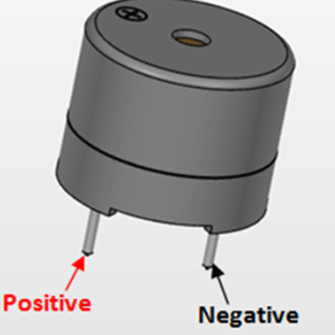
3.1.6 BUZZER
A buzzer is an electrical device that produces a sound when energized by an electrical signal. It works through the conversion of electrical energy into mechanical energy by a vibrating diaphragm or piezoelectric element. It is widely used in alarms, indicators, and other notification systems. There are various types of buzzers, such as piezoelectric and electromagnetic, which emit different sound frequencies and volumes. Buzzers are utilized in security systems, timers, and home appliances for the purpose of signaling an event or warning.
SPECIFICATIONS :
Table 6
Specifications | Details
Operating Voltage | 3V to 12V (common: 5V)
Operating Current | 20mA to 50mA
Sound Output Level | 85 dB to 100 dB (at 10 cm distance)
Frequency Range | 2 kHz to 4 kHz (common: 2.5 kHz)
Type | Piezoelectric
BUZZER DIAGRAM :
Buzzer 3.6

Slide 17
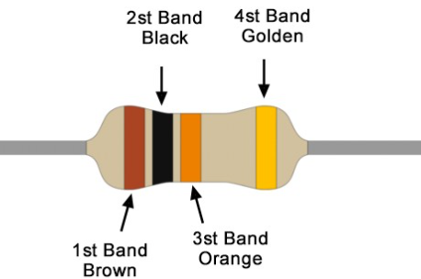
3.1.7 10K OHM RESISTOR
The component that limits or regulates flow in an electric circuit, converting electrical energy into heat, is a resistor that follows Ohm's law. Their values vary and are placed in electronic devices to handle a controlled voltage level and serve in keeping sensitive components protected.
10K OHM RESISTOR DIAGRAM :
Fig 3.7

Slide 18
BLOCK DIAGRAM :
Finger print Sensor
Arduino
5V Relay Module
BC547
Laser Light Module
Laser off
Laser module on
Ldr
buzzer

Slide 19
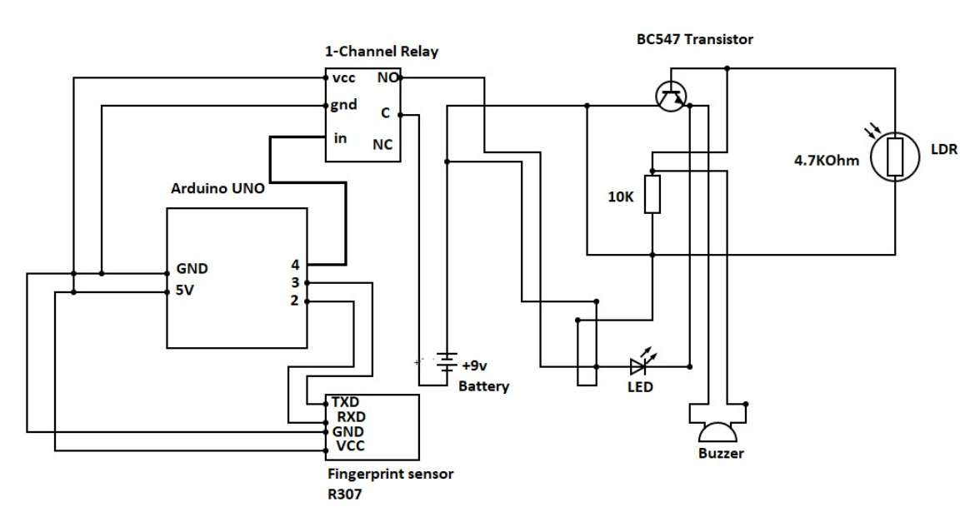
CHAPTER 4
CIRCUIT DIAGRAM
1. Actual Circuit Diagram :
Fig .4.1
2. Working :
The project integrates two circuits: a laser security system and a fingerprint recognition system. Only a person with a registered fingerprint can deactivate the laser security system and cross safely. The fingerprint sensor serves as the input for the entire circuit.
When a person provides their fingerprint, the fingerprint sensor transmits the data through its Transmit Pin (TXD) to the Arduino Uno, which verifies the input against the previously stored fingerprint data.
If the fingerprint matches the stored data:
1. The Arduino sends a HIGH signal to digital output Pin 8, which is connected to a relay module.
2.The relay temporarily deactivates the laser module, causing the laser beam to disappear for a few seconds, allowing the person to pass.
3.After the delay, the laser system automatically returns to its normal active state.
If the fingerprint does not match the stored data:
The Arduino does not trigger the relay, and the laser remains active without any interruption.

Slide 20
Additionally, if a person disturbs the laser beam without providing valid input to the fingerprint sensor, a buzzer is activated to signal unauthorized access.
Let’s Elaborate the roles of components to run this circuit :
Fingerprint sensor role :
The sensor captures the fingerprint image using its optical technology it processes the captured image and extracts minutiae points (unique features of the fingerprint) these minutiae points are converted into a digital template representing the fingerprint.
The digital template is then transmitted as a digital signal through the sensor's TX pin (Transmit Pin) to the connected device like Arduino.
Arduino role :
Arduino deals with the Relay module and the Fingerprint Sensor.
It get input from the sensor and it gives the output which acts as the input for the relay module.
The Arduino manages the timing for how long the laser remains deactivated after a valid fingerprint is detected.
This is achieved using simple code functions like delay( ).
We can register upto 240+ fingerprints in this Arduino.
Relay Module role:
The relay module acts as an electronic switch that allows the Arduino to control the power to the laser module.
Prevents damage to the Arduino by separating its low-power control circuit from the high-power laser circuit.
When Relay gets the high signal it disconnects the laser module from the power supply, turning it off temporarily and when it gets low signal it restores power to the laser module, and the laser becomes active again.
Transistor(BC547) role :
The Base receives a small current from the Arduino, turning the transistor ON.
The Collector allows a larger current to flow from the power source to the laser module.
The Emitter sends the current to GND, completing the circuit and powering the laser.
LDR role:
When the laser falls on the ldr it will decrease it’s resistance when the laser does not falls on the ldr it eventually increases the resistance of it and makes the current to flow from the buzzer.

Slide 21
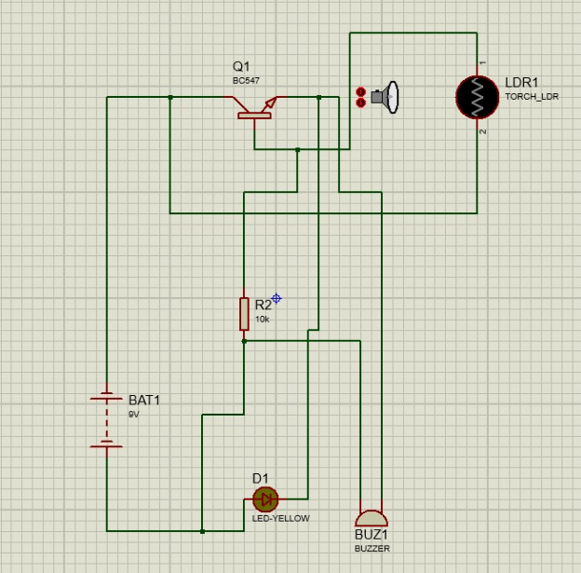
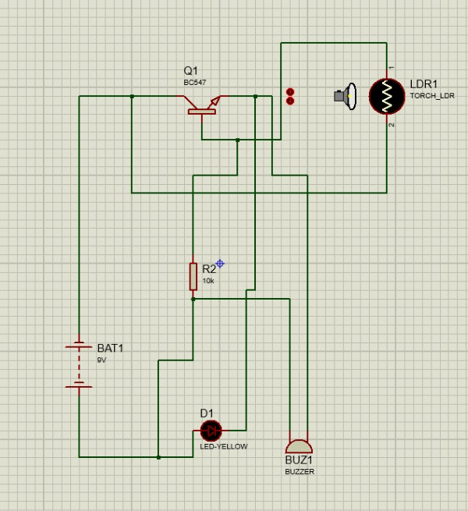
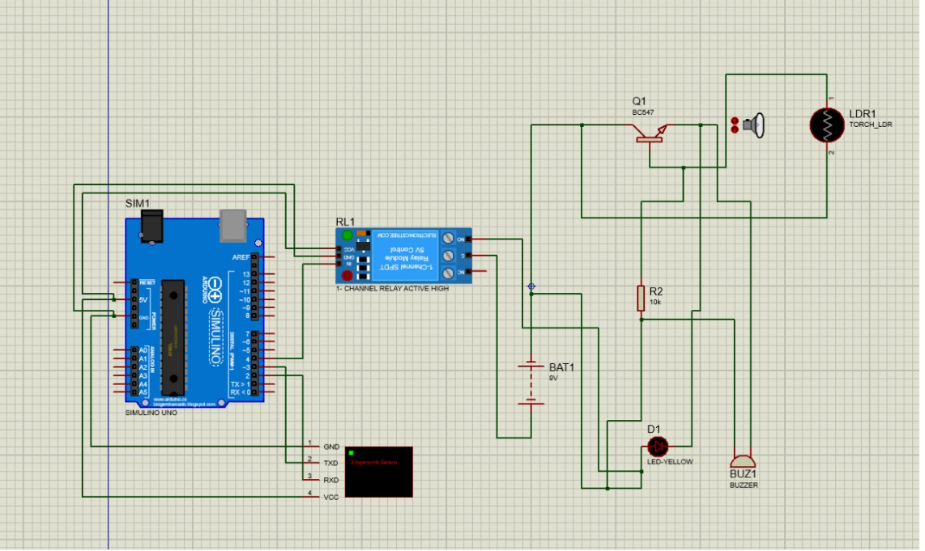
CHAPTER 5
5.1 Software Implementation
IMPLEMENTATION AND RESULTS
Fig .5.1 Disturbed Path
Fig .5.2 Continuous Path
Fig .5.3 Circuit with Arduino UNO

Slide 22
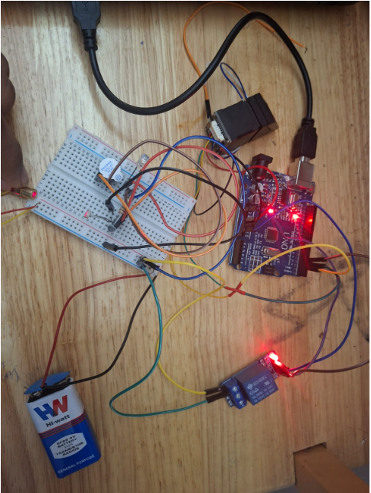
5.2 Hardware Implementation
Software implementation was done in the Proteus, a popular software where it is used for circuit design simulation, Microcontroller simulation, Iot prototypes and error detection etc. To model this project, components for laser security system are present in proteus but for components like arduino, Fingerprint sensor and relay module we need to install library from external souces[6]. The Proteus environment allows us to design and test the circuit before implementing it physically, ensuring the functionality of the system is verified. Here the input is given to the sensor through Ascii file [7] if the file is matched with the stored data the system will work step by step. This software implementation in Proteus helps visualize the entire process, identify potential issues, and refine the design before physical assembly.
1. Laser module Connection:
VCC → Arduino 5V
GND → Arduino GND.
Position the laser to shine directly on the LDR for normal operation.
2. Finger Print Sensor Connection:
VCC → Arduino 5V.
GND → Arduino GND.
TX → RX on Arduino (Pin 2).
RX → TX on Arduino (Pin 3).
3. 5V Relay Module Connection:
VCC (Relay) → Arduino 5V.
GND (Relay) → Arduino GND.
Signal (IN) → Arduino digital pin (Pin 8).
Fig 5.2.1

Slide 23
CHAPTER 6
ADVANTAGES & APLICATIONS
Some advantages of this project :
  Combines biometric authentication with laser-based intrusion detection, providing dual-layered protection.
  The laser and LDR setup can detect any physical tampering or obstruction, triggering alarms for immediate action.
  Uses affordable components like LDRs, transistors, and microcontrollers, making the system accessible for various budgets.
  The system operates on low power, with components like lasers and sensors optimized for minimal energy consumption.
  User-friendly operation through biometric authentication eliminates the need for keys or passwords, which can be lost or forgotten.
  The design can be expanded to include additional sensors, cameras, or alarms for larger-scale applications.
  Alerts can be configured and expanded as SMS notifications or IoT-enabled responses for real-time monitoring
  Some Applications of this project :
  Ideal for offices, retail stores, and warehouses to safeguard against theft and unauthorized entry.
  Effective in protecting sensitive areas like data centers, research labs, and government facilities.
  Can be used to restrict access to vaults or ATMs, ensuring that only authorized staff can gain entry.
  Useful in securing examination halls, libraries, or restricted campus areas.
  Protects inventory and sensitive equipment by restricting access to authorized personnel in factories and plants.
  Ensures secure access to restricted areas such as drug storage rooms, operating theaters, or record rooms.
Can be adapted for personal lockers, safes, or private storage units.

Slide 24
CHAPTER 7
CONCLUSION & FUTURE SCOPE
Laser security systems are one of the most integral parts of modern security strategies. They offer better protection to residential and commercial properties. These systems provide a high degree of accuracy in detecting unauthorized entry or movement using laser beams that create an invisible barrier. The key benefits of laser security systems include large area coverage, minimal installation requirements, and rapid intruder detection, which can trigger alarms or alert security personnel. They are effective in high-security zones, warehouses, and the periphery of buildings in terms of additional protection from theft, vandalism, and unauthorized access.
Automatic operation and low maintenance needs ensure that they are efficient and cost-effective in the long run. Laser security systems have become vital in safeguarding assets and properties and should be encouraged to increase their spread. The future for laser security systems is looking positive, as it continues its rapid growth with developments and increasing demand for smart solutions in security. This smart security system will grow much more intelligent, employing both AI and IOT technology, to achieve precise detection along with the reduction of false alarms. Laser security devices will also be integrated into other security devices, thus creating a more cohesive reaction. Future innovations are going to make laser beams more efficient, thereby ensuring greater coverage and better accuracy in detection. Wireless technology will make installation and subsequent maintenance much easier, including in older or remote buildings. The next generation laser security system will be much more energy-efficient and focused on the use of eco-friendly material, smarter, cost-effective and environmentally friendly without compromising protection.

Slide 25

REFERENCES
[1] B. Giri raju, T. Snehitha, P. Keerthana, K . Bayapu Reddy; Laser Light Security System; International Research Journal of Modernization in Engineering Technology and Science; Published Date : June – 2022
[2] Tatya Bhimrao Shingate, Vijaya Ramdas Umap, Abhijeet Abhiman Rathod, Prof. Santosh H Lavate; A Laser and Computer Vision-Based Security System; International Engineering Research Journal (IERJ) ; Publishedd Date : 11/03/ 2020
[3] Sudarshan , Harshitha , Janhavi ; Laser Based Security System ; International Advanced Research Journal in Science, Engineering and Technology ;Published Date: July – 2021
[4] Ravi shankar, Sudha, Manjesh, Sudarshan, Subhash, Surendra kumar; Implementation of Laser Security System; International Journal of Advance Research and Innovative Ideas in Education;
Published Date: March - 2024
[5] Ajit Kumar Patro1, Kanha Mirdha, Subha Prasad Behera , Piyush Patel , Abhishek Tripathy; Design and Analysis of LDR Based Laser Security System; International Research Journal of Engineering and Technology (IRJET); www.irjet.net; Published Date : April – 2024
[6] Arduino Library - https://electronicstree.com/new-arduino-uno-r3-free-proteus-library/
Relay Library - https://electronicstree.com/arduino-relay-modules-for-proteus/
Fingerprint sensor Library - https://www.arduinolibraries.info/libraries/adafruit-fingerprint-sensor-library
[7]

